Slide 1
LULUSAN TEKNIK SIPIL UM SIAP SUKSES menghadapi MASYARAKAT EKONOMI ASEAN
Umar Kadafi,MCE, MOS

Slide 2
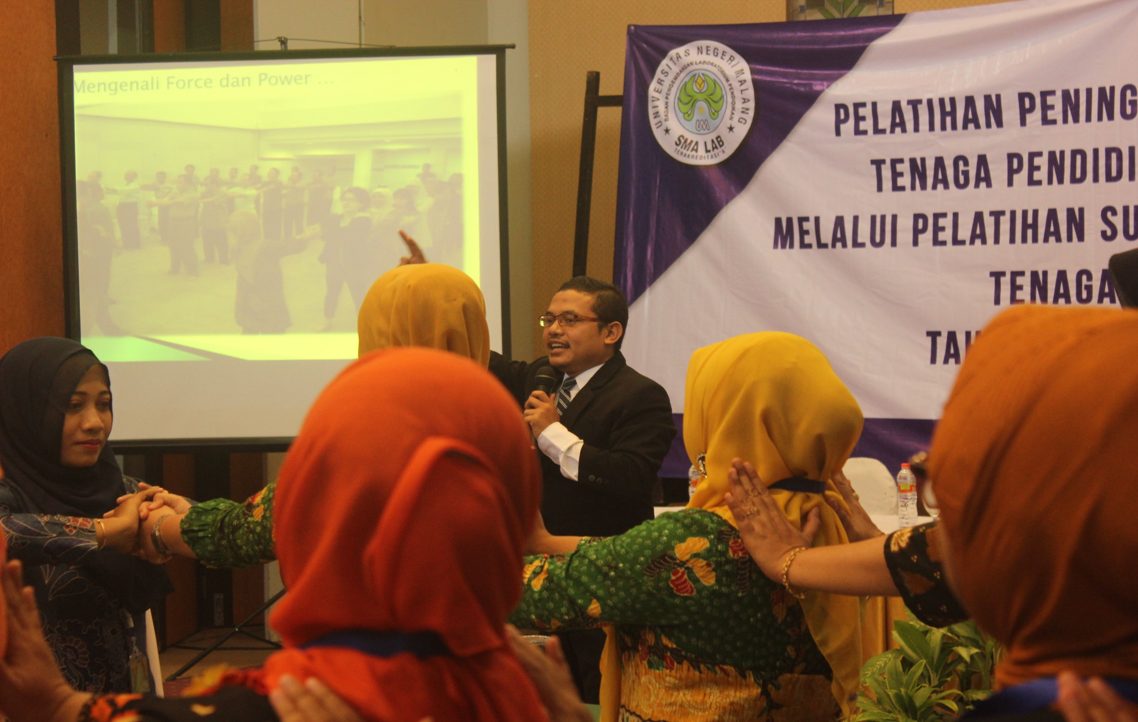

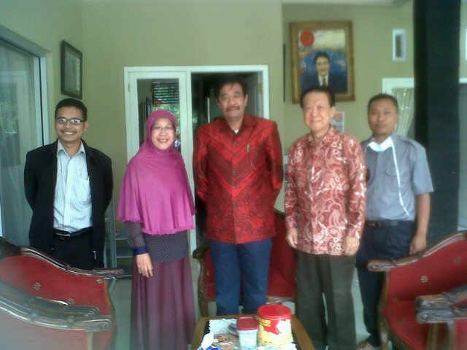
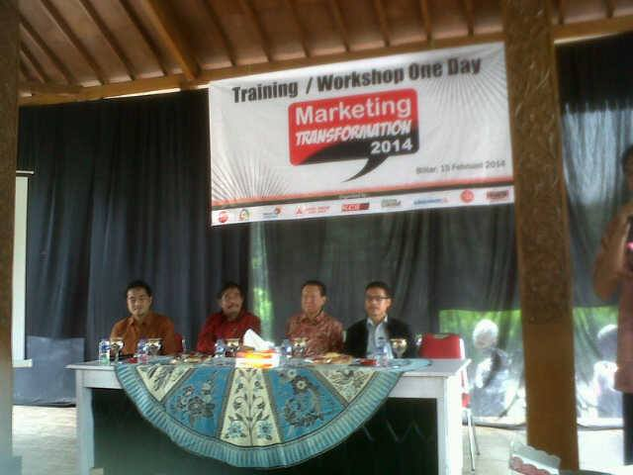
Umar Kadafi, MOS, MCE
TempAt lahir : Bima-NTB
Status : Berkeluarga
Pekerjaan : 1. Direktur AEP Microsoft Wilayah Jawa TImur
2. Direktur PT.Green Bact Indonesia
Kantor:
Gandaria City Tower 8 Lantai 21 Jakarta Selatan
Gedung FMIPA UM Lantai 1
Pendidikan FORMAL
S1 Pendidikan Biologi UM
S2 Pendidikan Biologi UM
Pendidikan InFormal
Certified Hipnosis dan Hipnoterapi IBH Jakarta
Certified Intruktur Nasional IBH Jakarta
Seft dari Logos Therapy
NLP dan Quantum Ikhlas Erbe Sentanu
Certified mos MCE Certiport USA

Slide 3
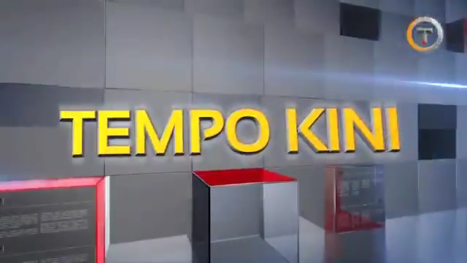

Slide 4
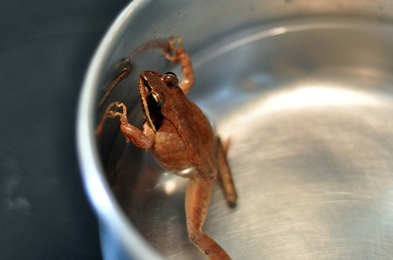


Slide 5
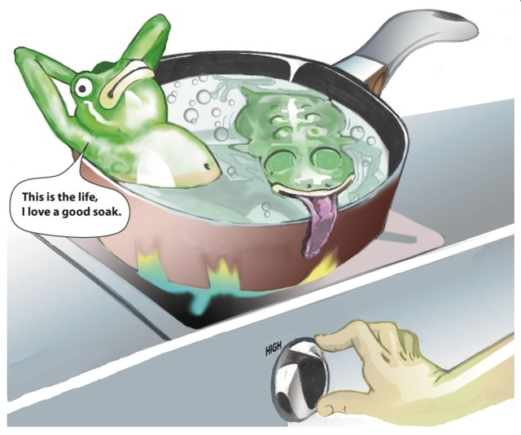

Slide 6
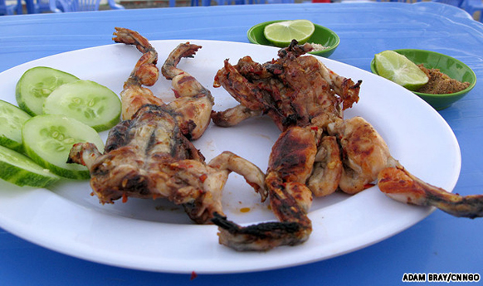

Slide 7
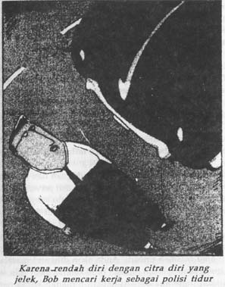
JIKA SESEORANG TIDAK MAU BERUBAH,
BAIKLAH IA JADI POLISI TIDUR SAJA.

Slide 8
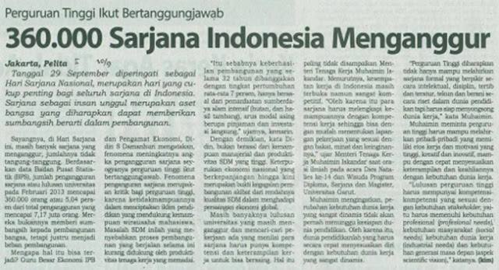

Slide 9
MENGAPA
ORANG TIDAK SUKSES
Keyakinan yang salah.
Tidak punya tujuan.
Merasa tujuan tidak masuk akal.
Tidak merasa “HARUS”.
Tidak punya strategi yang terbukti.

Slide 10
SOLUSINYA…..
DESTROY THE LIMITING BELIEF
OUT COME
UNLEASH
THE POWER
WITHIN
SKILL
BELIEF

Slide 11
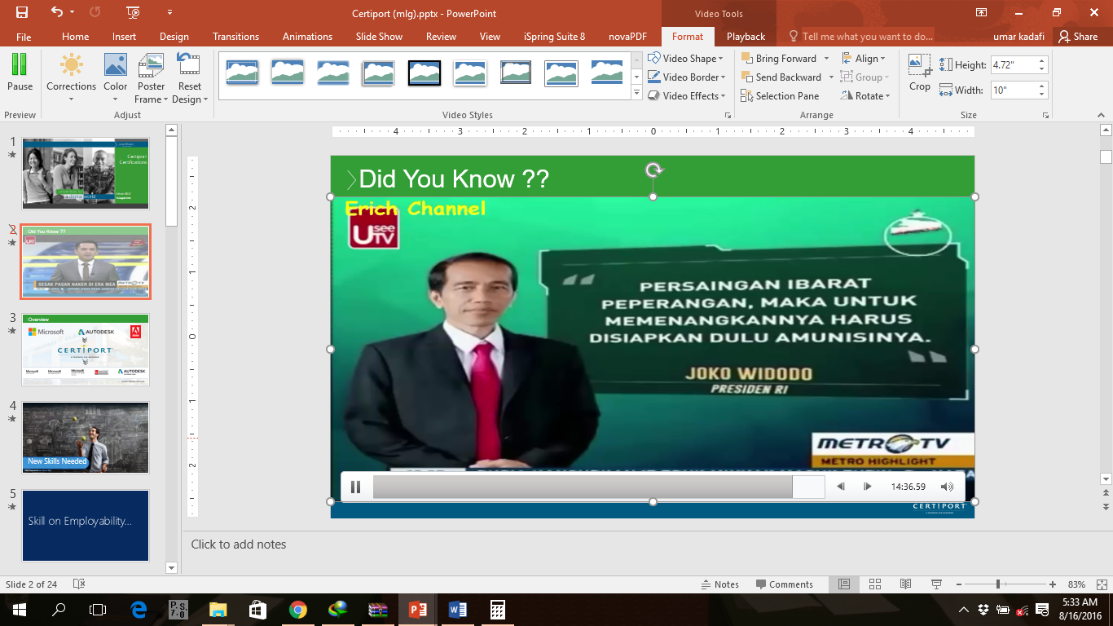

Slide 12
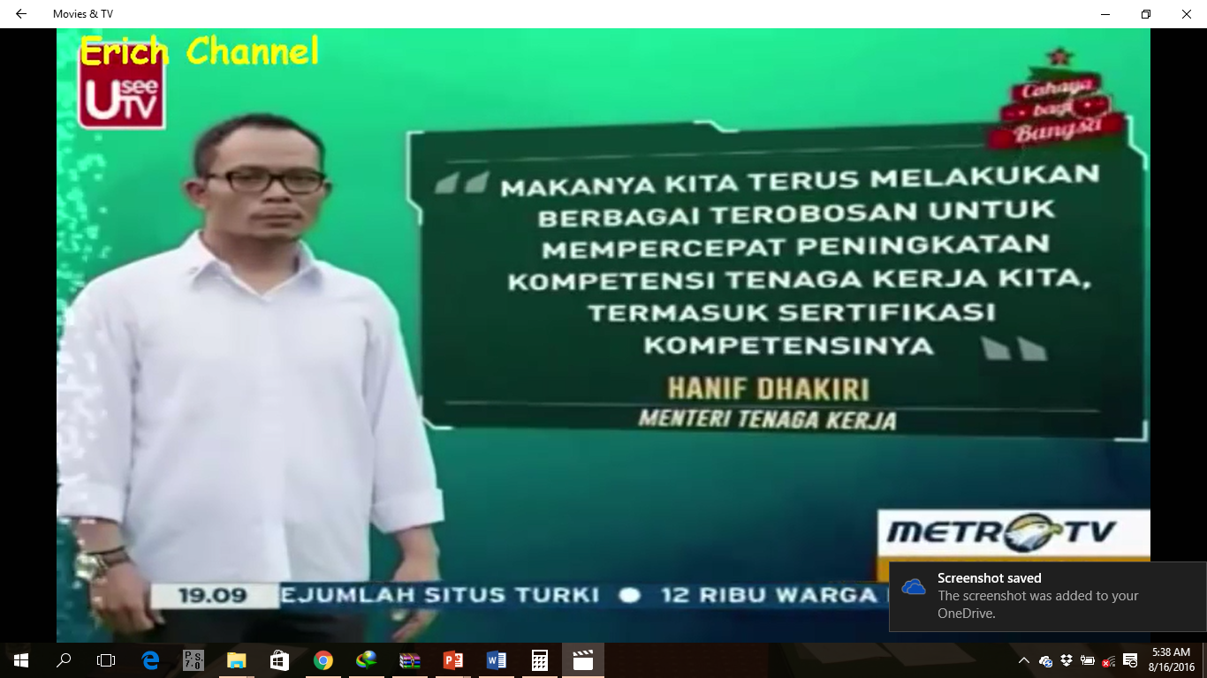

Slide 13
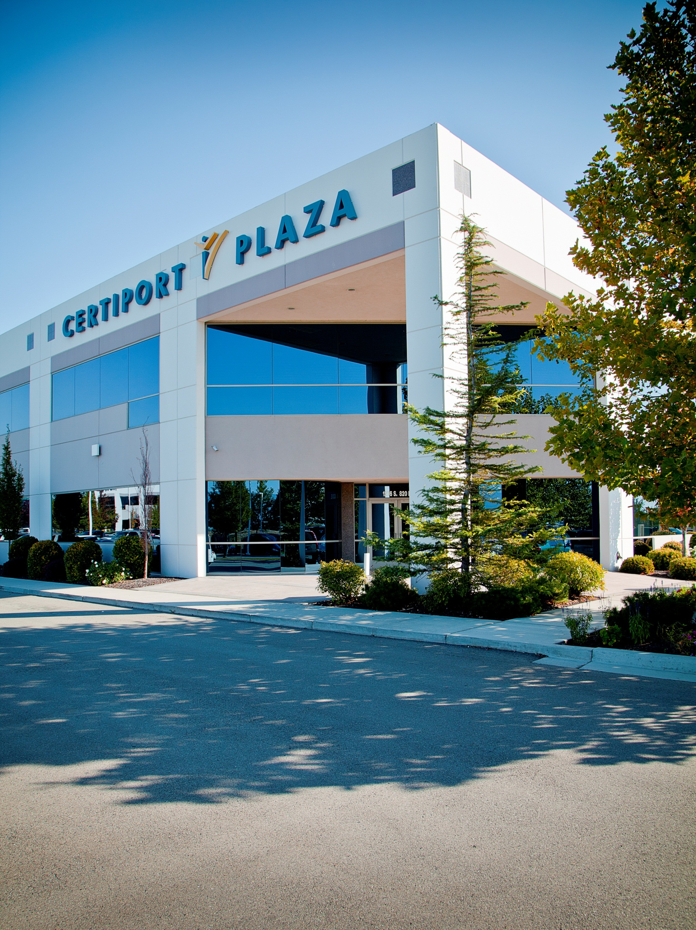










Overview
www.certiport.com
Notes:
Certiport is the world leader in performance-based certification exams for academic institutions. We are the providers of more than 60 active certifications from companies like Microsoft, Adobe, HP, Intuit, Autodesk, and CompTIA.
We currently deliver nearly two million certification exams each year, including over one million Microsoft® Office Specialist (MOS) exams, which makes that particular program the largest IT certification program in the world. Our exams are delivered in over a 150 countries and 27 languages. (As of Dec 2012, 152 countries and 27 languages)
Certification products such as Microsoft Office Specialist (MOS), the Adobe Certified Associate (ACA), HP Accredited Technology Associate (HP ATA) and the Internet and Computing Core Certification (IC³) are delivered through an expansive network of over 12,000 partners in 152 countries.

Slide 14


New Skills Needed
APAC Education Partner Summit 2013

Slide 15
Skill on Employability…

Slide 16


More than 50% of today’s
jobs require some technology
skills, and experts say that
percentage will increase to
77% in the next decade.
IDC 2012
APAC Education Partner Summit 2013

Slide 17

One in Four US IT Jobs Unfilled
Due to lack of certification, training, or experience
IDC Research July 2012

Slide 18
Skills Needed in the Economy Today?
SKILLS REQUIREMENTS FOR TOMORROW'S BEST JOBS –IDC Research, October 2013
Dependability
Oral and written communication skills
Detail oriented
Microsoft Office
Customer service oriented
Organizational skills
Problem solving skills
Self-starting/self-motivated
Project management
Time management
Data entry
1
2
3
4
5
6
7
8
9
10
11
12
13
% of positions US Data (25,000 total)

Slide 19
Skill Validation is the Solution !!!

Slide 20
Benefits
Global Impact
A competitive edge
Better job opportunities
Heighten your earning potential
Differentiate from other applicants
Gain experience and confidence

Slide 21


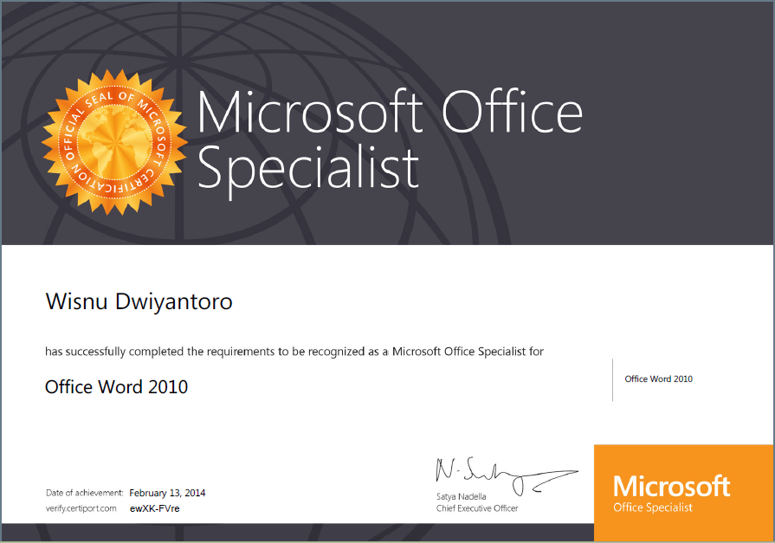
Umar Kadafi
Office Excel 2013

Slide 22
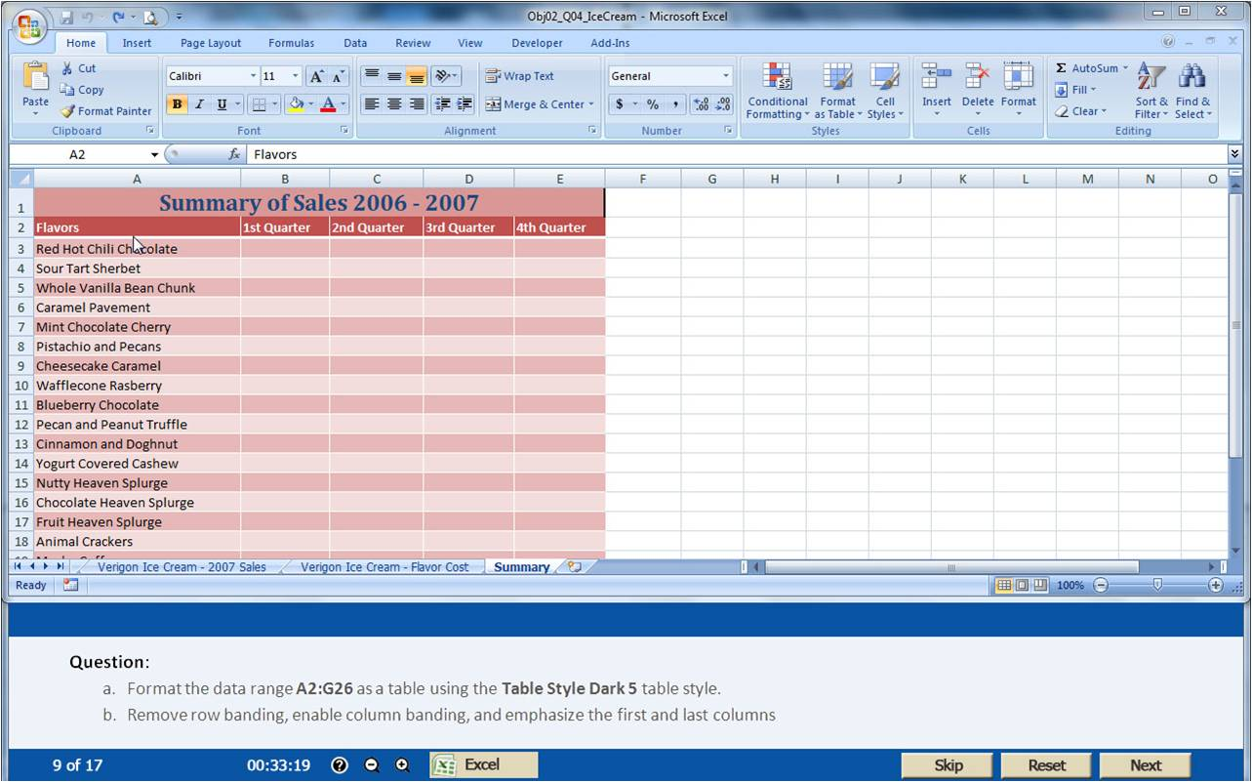
Exam Screenshot (MOS)

Slide 23
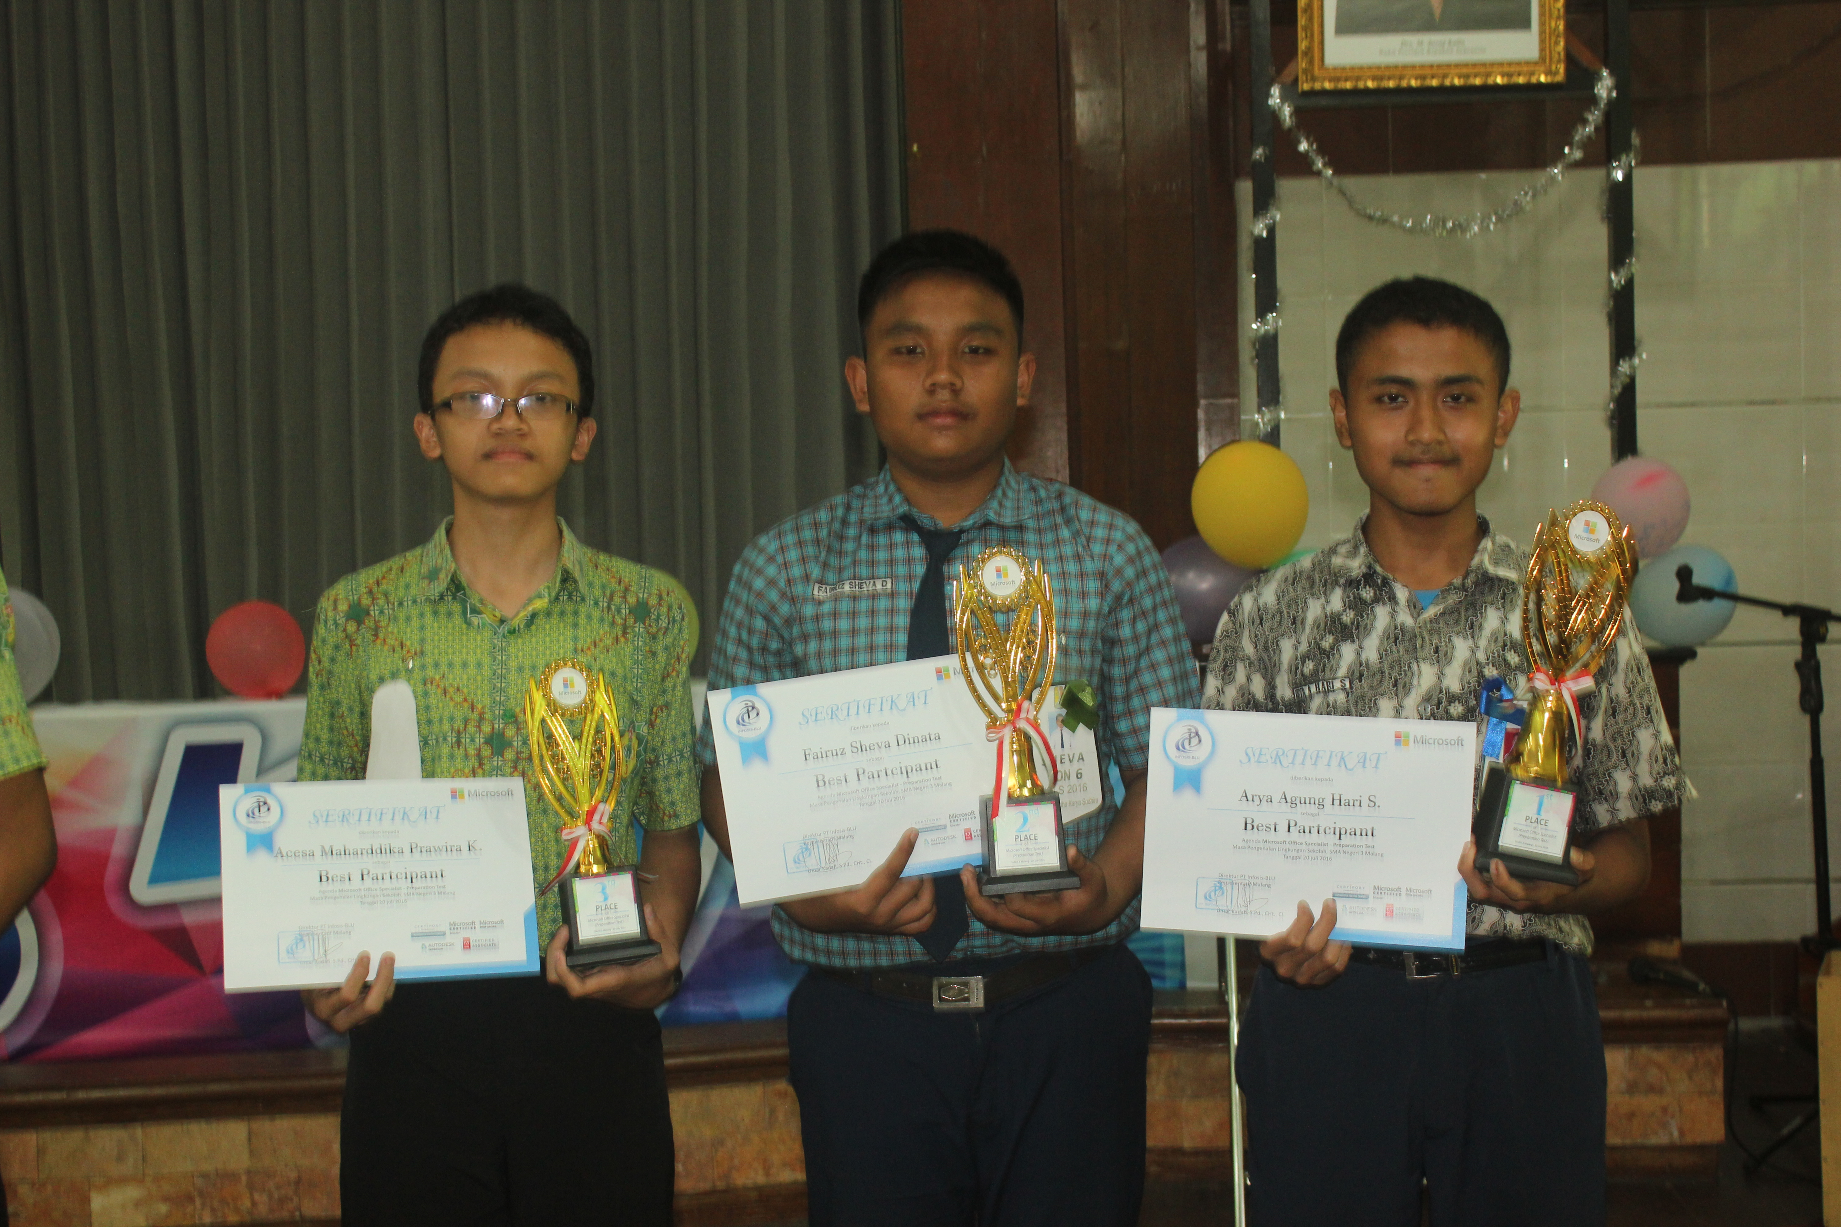
KOMPETISI NASIONAL
KOMPETISI ANTAR MAHASISWA STIE ABM Kucecwara
KOMPETISI NASIONAL

Slide 24

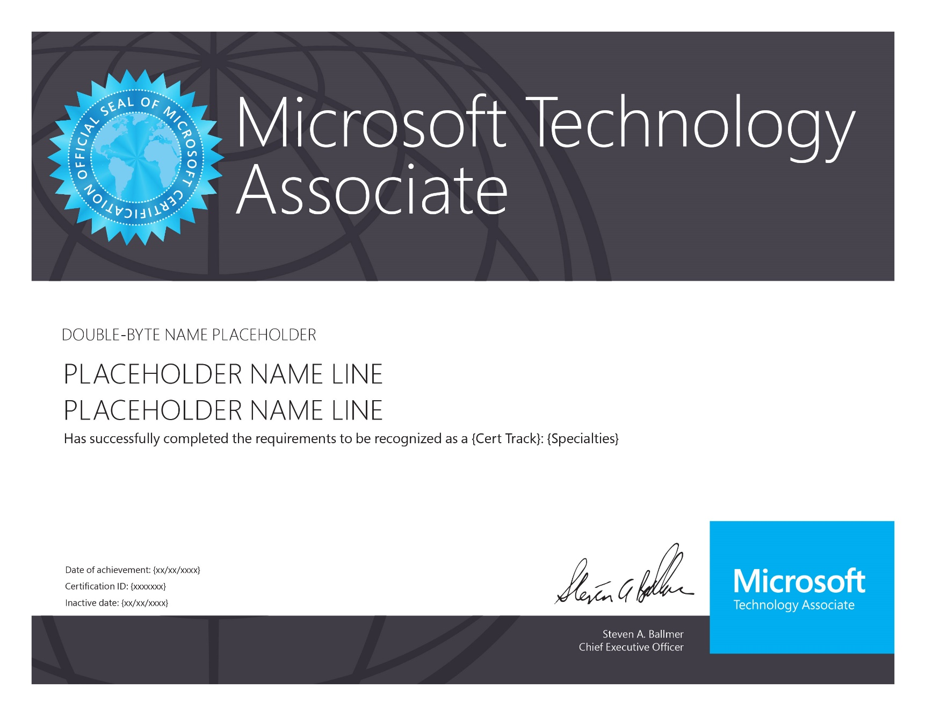
Developer Exams
Software Development Fundamentals
HTML5 Application Developer Fundamentals
Software Testing Fundamentals
Mobility and Device Fundamentals
Cloud Fundamentals
IT Professional Exams
Windows Server Administration Fundamentals
Networking Fundamentals
Security Fundamentals
Windows Operating System Fundamentals
Database Exam
Database Administration Fundamentals

Slide 25
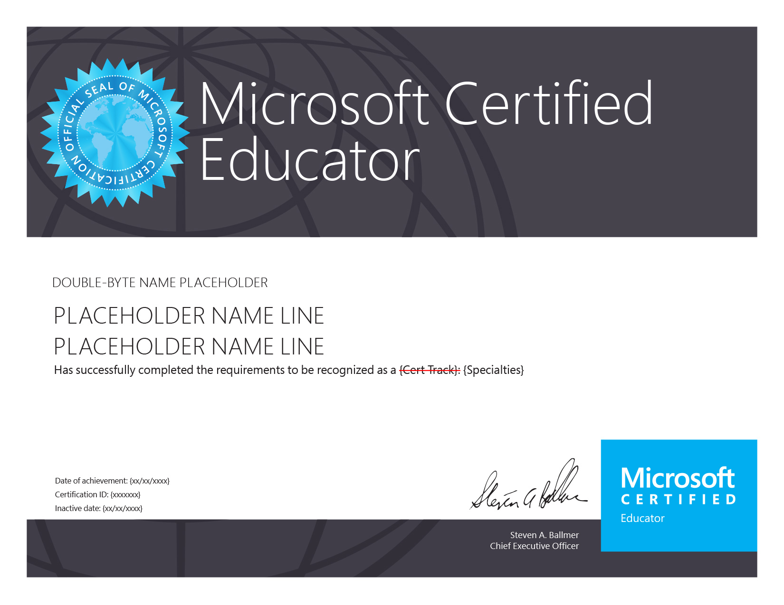
Technology Literacy for Educators
Based on UNESCO ICT Competency Frame work

Slide 26


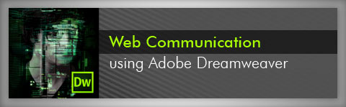

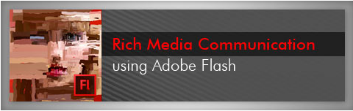
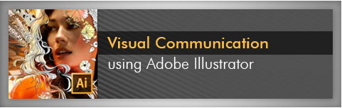
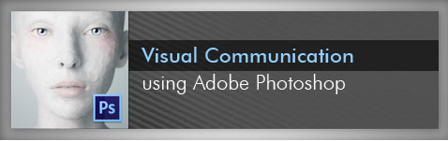


Slide 28
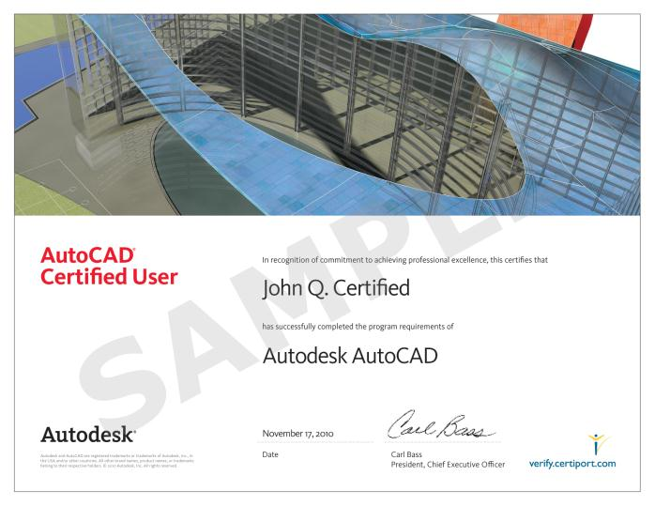
AutoCAD
Revit Architecture
Inventor
Maya
3D MAX

Slide 29
Get Started Today!

Slide 30
Thank you…

